Slide 1

Home Credit Default Risk Kaggle Competition
This presentation explores the Home Credit Default Risk Kaggle competition, diving into the complexities of predicting loan repayment and leveraging machine learning to tackle this challenging problem. We'll cover the data, our approach, and insights we gained.

Slide 2
About Us
Prepared by: Kareem Ayman, Muhammad Emad, Aya Elmalah, Shereen Ebrahim
Instructor: Eng Mohamed Alqablawi

Slide 3
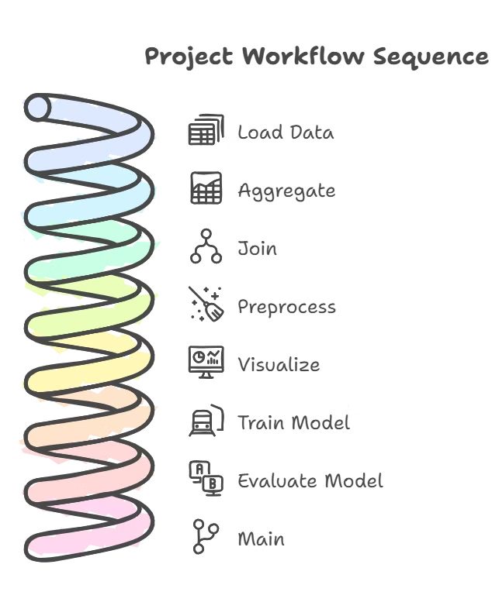
Project Structure and Workflow
1
Load Data
Read the input datasets into dataframes.
2
Aggregate
Combine related data for analysis and modeling.
3
Join
Merge dataframes based on shared keys for a comprehensive view.
4
Preprocess
Clean, transform, and prepare data for modeling.
5
Visualize
Explore and understand the data through visual representations.
6
Train Model
Build and train a machine learning model for predicting loan repayment.
7
Evaluate Model
Assess the model's performance using relevant metrics.
8
Main
The main script that orchestrates the entire process.
9
Streamlit
Create an interactive web application for visualizing results.
10
ReadMe
Document the project's purpose, workflow, and usage instructions.
11
Github Push
Share the project's code and documentation on Github for collaboration.

Slide 4
Introduction to Home Credit and the Competition
Home Credit
The Competition
Home Credit is a global financial institution specializing in consumer lending. They operate in various countries and provide financial solutions to individuals.
This Kaggle competition challenged participants to build a model that predicts the probability of loan defaults for Home Credit's clients. It provided a massive dataset with rich information about borrowers.

Slide 5
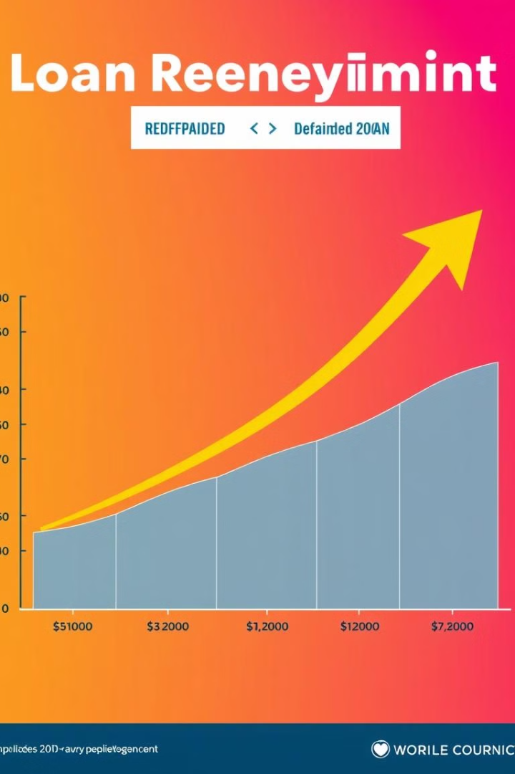
Understanding the Business Problem and Objectives
1
Business Problem
2
Objectives
Accurate prediction of loan defaults is crucial for financial institutions to manage risk and make informed lending decisions.
The objective was to develop a machine learning model that could accurately predict the probability of loan defaults based on the provided data.
3
Impact
The model's predictions could assist Home Credit in making better loan decisions, reducing potential losses, and improving overall business outcomes.

Slide 6
Overview of the Dataset and Data Cleaning
Dataset Structure
Data Cleaning
The dataset encompassed a wide range of information, including borrower demographics, credit history, loan details, and external data sources.
The initial steps involved cleaning the data, addressing missing values, handling inconsistent data, and transforming features for compatibility with machine learning models.

Slide 7

Data Aggregation & Joins
The dataset consisted of multiple tables containing different aspects of the data. We aggregated these tables using joins to combine relevant information for each borrower.
Example
Purpose
We joined the application table with the bureau table using the SK_ID_CURR to link each borrower's application data with their credit history.
This aggregation allowed us to create a comprehensive view of each borrower's profile, including their loan details, credit history, and demographic information.

Slide 8
Data Preprocessing
Handling missing values: Replacing or imputing missing data points using techniques like mean imputation, median imputation, or model-based imputation
Addressing duplicate values: Identifying and removing redundant entries to ensure data integrity and prevent bias in modeling
Transforming features: Converting categorical variables into numerical ones using techniques like one-hot encoding or label encoding

Slide 9

Exploratory Data Analysis (EDA) on Key Features
Age and Income
Credit History
Examined the relationship between borrower age, income, and loan repayment behavior, identifying potential correlations.
Analyzed borrower credit history, including past loan defaults, payment patterns, and credit scores, to understand their impact on loan defaults.
Loan Amount and Term
Explored the influence of loan amount, loan term, and other loan-related features on the likelihood of loan defaults.

Slide 10
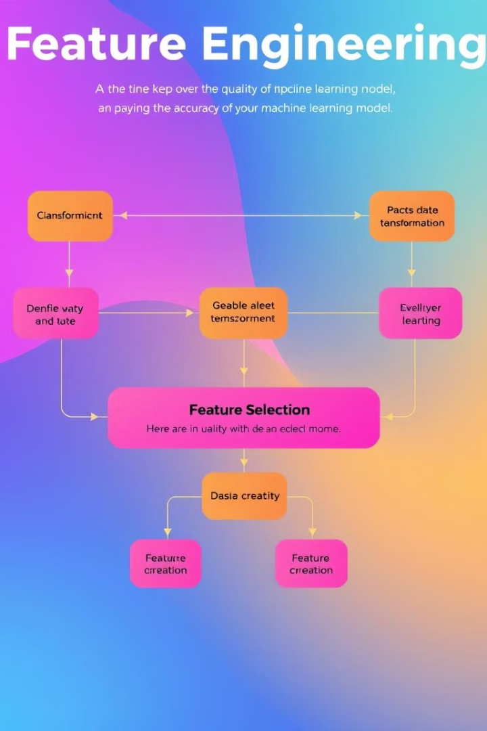



Feature Engineering and Selection
Feature Transformation
Feature Creation
Applied various transformations to existing features, like log transformations, normalization, and encoding categorical variables.
Generated new features by combining existing features, such as interaction terms and ratio-based features.
Feature Selection
Utilized techniques like feature importance scores and recursive feature elimination to identify the most predictive features for the model.

Slide 11
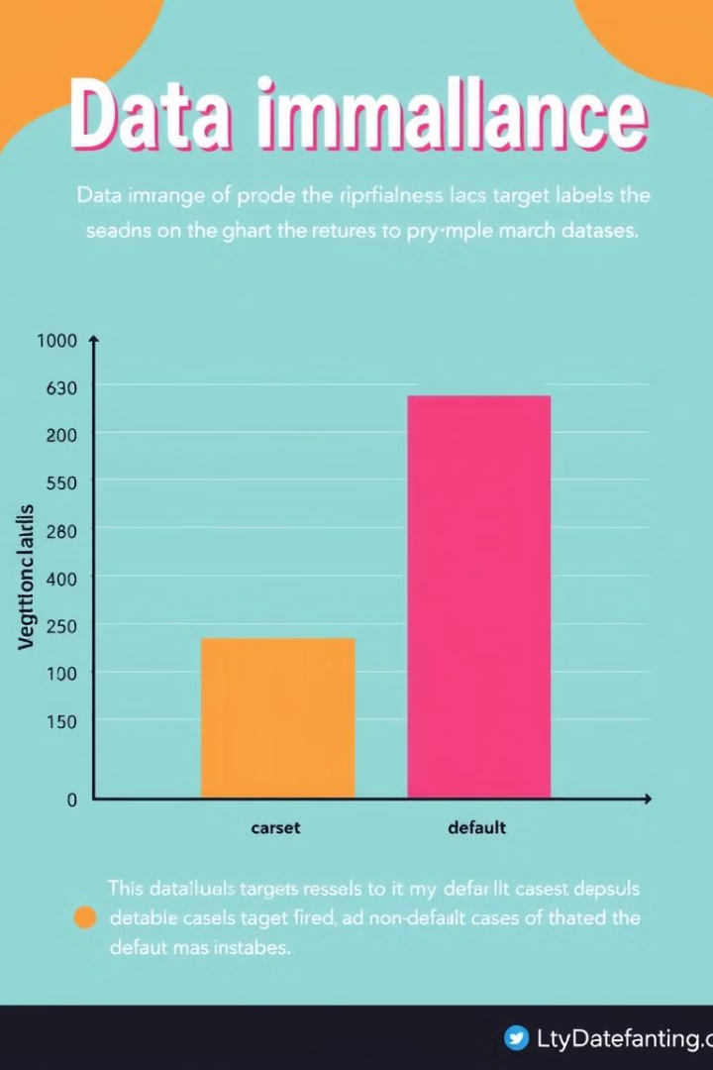
Handling Imbalanced Data
1
Class Imbalance
The dataset exhibited a significant imbalance in the target variable, with a much higher proportion of non-defaulting loans compared to defaults.
2
Addressing Imbalance
Implemented techniques like oversampling, undersampling, and cost-sensitive learning to mitigate the impact of class imbalance on model performance.
3
Evaluation
Evaluated the model's performance using metrics appropriate for imbalanced datasets, like F1 score, precision, and recall, ensuring accurate prediction of defaults.

Slide 12
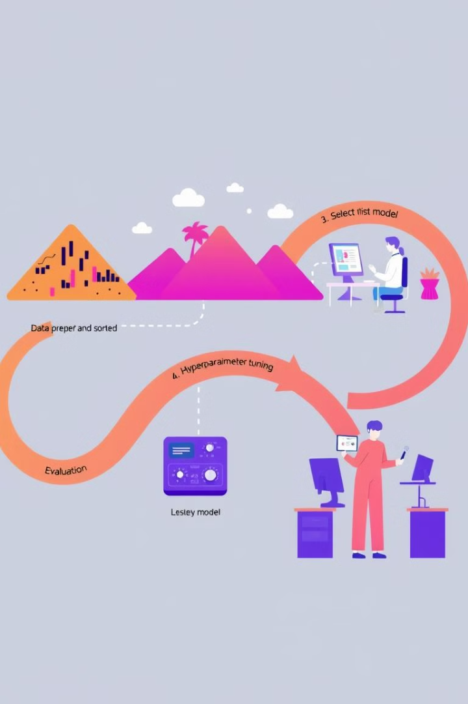



Modeling Approach and Evaluation Metrics
Model Selection
Used machine learning models like Logistic Regression, Random Forest, and XGBoost to predict customer defaults. Selected LightGBM as the primary modeling approach due to its efficiency, ability to handle large datasets, and strong performance in classification tasks.
Evaluation Metrics
Employed metrics such as AUC (Area Under the ROC Curve), F1 score, and log loss to evaluate the model's ability to distinguish between defaulting and non-defaulting loans.
Model Tuning
Used hyperparameter optimization techniques such as grid search and random search to find the best-performing models.

Slide 13
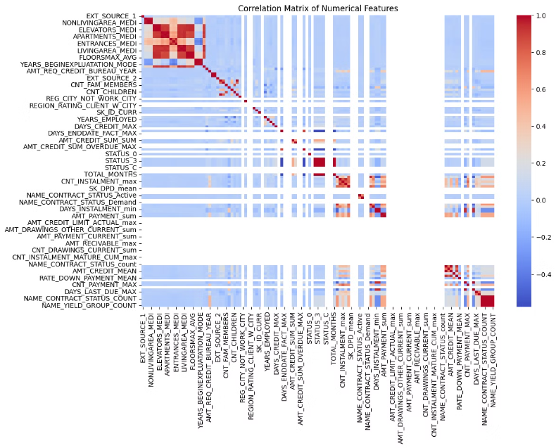
Correlation Matrix of Numerical Features
A correlation matrix is a visual representation of the relationships between numerical features in a dataset. It helps identify strong positive or negative correlations, which can reveal key insights. For example, a high positive correlation between loan amount and default rate might suggest that larger loans are associated with a higher risk of default.

Slide 14
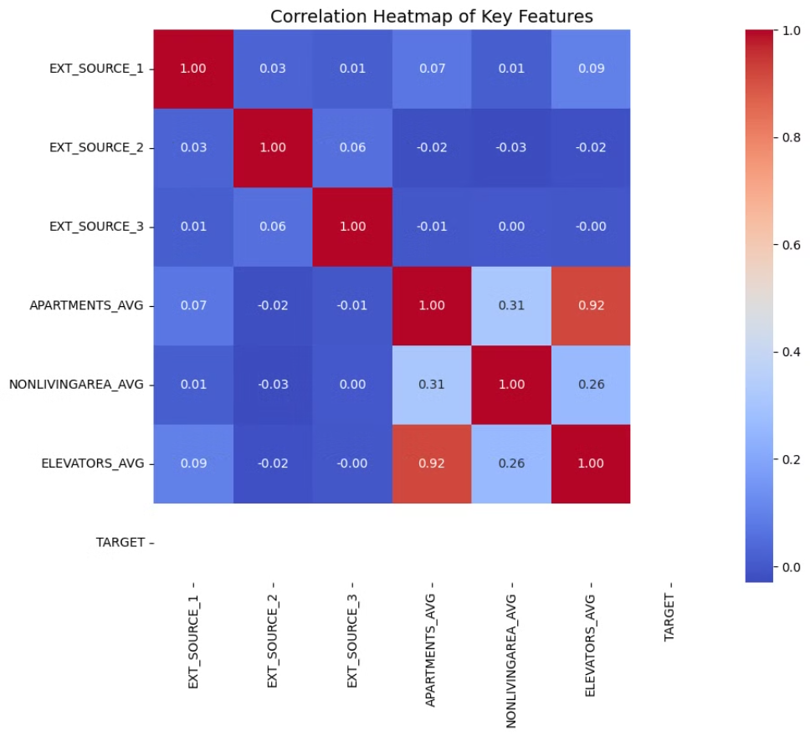
Correlation Heatmap of Key Features

Slide 15



Building an Ensemble of LightGBM Models
Ensemble Modeling
1
Developed an ensemble of multiple LightGBM models trained on different subsets of the data or with varying hyperparameters. Model performance was evaluated using AUC-ROC, Accuracy, and F1 Score.
Bagging and Boosting
2
Implemented techniques like bagging and boosting to improve model robustness and reduce the risk of overfitting. Model performance was evaluated using AUC-ROC, Accuracy, and F1 Score.
Prediction Averaging
3
Averaged the predictions of individual models in the ensemble to produce a final prediction for each loan application. The final ensemble model's performance was evaluated using AUC-ROC, Accuracy, and F1 Score.

Slide 16
Deployment and Monitoring of the Final Model
Model Deployment
1
Deployed the final ensemble model into Home Credit's loan decisioning system to provide real-time predictions for new loan applications.
Model Monitoring
2
Implemented a monitoring system to track the model's performance over time, identifying potential performance degradation and requiring adjustments.
Model Maintenance
3
Regularly retrained and updated the model with new data to ensure continued accuracy and effectiveness in predicting loan defaults.

Slide 17
Model Performance Comparison
Model
Precision (0)
Recall (0)
F1-Score (0)
ROC-AUC
XGBoost
0.680672
0.786408
0.729730
0.984439
Random Forest
0.743243
0.533981
0.621469
0.978783
Logistic Regression
0.461538
0.058252
0.103448
0.755832
SVM
0.250000
0.009709
0.018692
0.530461

Slide 18
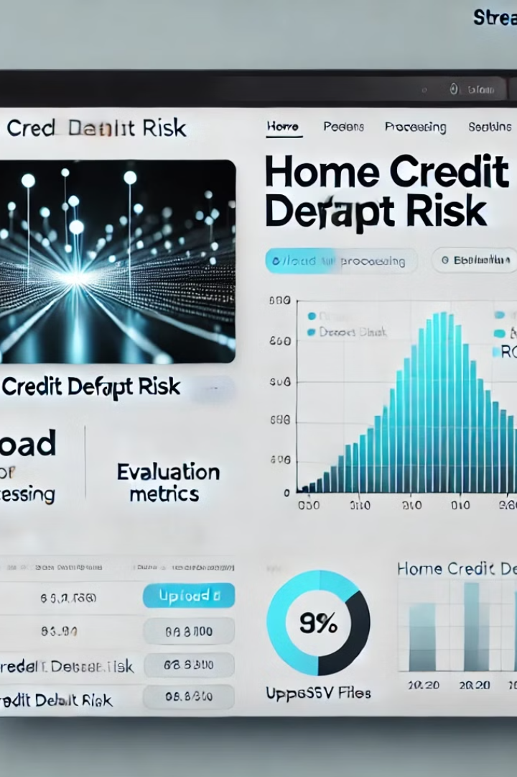
Streamlit View
Developed a user-friendly Streamlit dashboard to visualize key insights and model performance. Users can interact with the dashboard to explore various data points and gain a comprehensive understanding of the model's predictions.

Slide 19

Thank you for listening!

